Slide 1
GCBASIC
PIC18FxxQ35chip Family
Part 16 - Progmem, SAF memory, EEPROM and DATA blocks

Slide 2
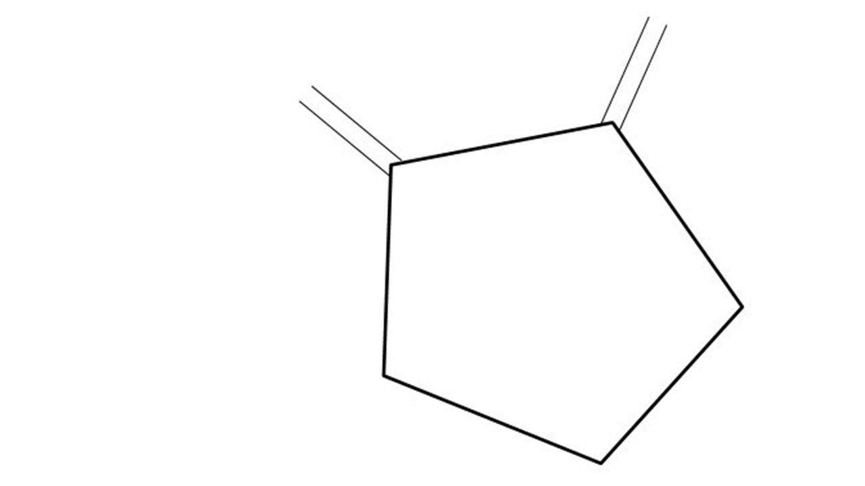
GCBASIC
PIC18FxxQ35chip Family
Part 16 - Progmem, SAF memory, EEPROM and DATA blocks

Slide 3
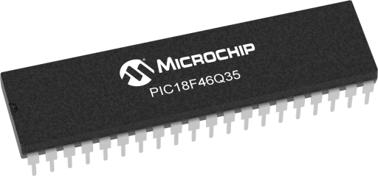
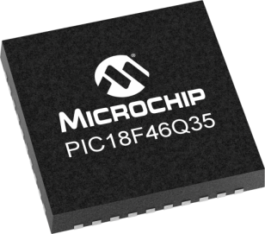
GCBASIC
Like and subscribe!

Slide 4
PIC18FxxQ35
PIC18FxxQ35 is a high performance PIC18
  Digital and analog peripherals for flexible embedded control
  10-bit ADC for accurate analog signal conversion
  Multiple communication interfaces including UART (serial), I²C, and SPI
  PWM modules with CCP and 16-bit resolution for precise timing and motor control
  Configurable Logic Cells (CLCs) for custom hardware-level logic without external components
  Integrated op amps for onboard analog signal conditioning and amplification
The PIC18FxxQ35 offers 28, 40 and 44-pin products in small footprint packages to support customers in a wide variety of applications.

Slide 5
Videos...
Install the hardware and make the board work – make LEDs work
Make four LEDs flash in a sequence
Set the LEDs to represent the value of ADC
Sequence the LEDs with a delay using the value of ADC
Using an input to set the state of the LEDs
Using the reset switch
Using the switch, ADC – make the LEDs flash in a sequence with reverse
Using the serial to display values
Using the timer0 overflow, 8bit timer, 16bit timer to flash the LEDs
Using EEProm – showing values on the serial terminal, and more constants insights
Using I2C with serial to discover I2C devices
Using an I2C GCLD display
Using a SPI GCLD display
Using PWM, many ways, to dim the LEDS
Using Millis and Interrupts
Using storage within the chip – Progmem, SAF memory, EEPROM and DATA blocks
Using CLC
The GCBASIC tool chain
Assembly , alternatives assemblers and MPLAB-X
Summary

Slide 6
GCBASIC Compiler
GCBASIC Compiler
GCBASIC is an Open Source compiler for PIC, AVR and LGT microcontrollers
GCBASIC now supports the 18FxxQ35 chip family
GCBASIC now supports 1400+ microcontrollers

Slide 7
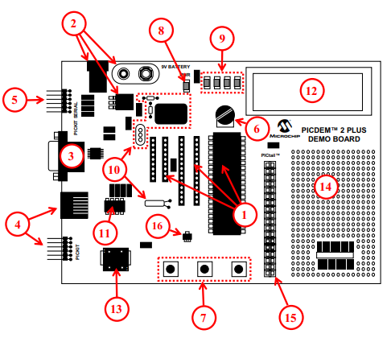
PICDEM 2 Plus Demonstration
Board
1. 18-, 28- and 40-pin DIP sockets
(although three sockets are provided, only one device may be used at a time)
2. On-board, +5V regulator for direct input from 9V, 100 mA AC/DC wall adapter or 9V battery, or hooks for a +5V, 100 mA regulated DC supply
3. RS-232 socket and associated hardware for direct connection to an RS-232 interface
4. Programmer/debugger connectivity supporting MPLAB® ICD 3, MPLAB REAL ICE and PICkitPlus
5. PICkit Serial Connector for analysis of serial communications peripherals such as SPI or I2C™
6. 5 k pot for devices with analog inputs
7. Three push button switches for external stimulus and Reset
8. Power-on indicator LED
9. Four LEDs connected to PORTB
10. On-board external oscillators including:
a) Unpopulated DIP socket for canned crystal oscillator (Y2)
b) RC oscillator circuit (R4, C3)
c) Unpopulated holes for crystal connection (Y1)
d) 32.768 kHz crystal for Timer1 clock operation (Y3)
11. 32K x 8 Serial EEPROM
12. LCD display
13. Piezo buzzer
14. Prototype area for user hardware
15. Expansion Header for PICtail™ daughter card connectivity or user access to MCU pins
16. Microchip TC74 thermal sensor
Plus SPI GLCD
3A

Slide 8
Storage Overview Types
 | Type | Characteristics
1 | Progmem | Program, and, Storage Area Flash (SAF) block
2 | Data RAM | Volatile
3 | Data EEPROM | Consider as a peripheral

Slide 9
Program Flash Memory ( PFM )
PIC18FxxQ35
PIC18FxxQ35
Progmem usage
  Your program
  and/or
  Reference data
  Pictures
Uses PFM direct addressing
Program
Program Flash Memory
Program Flash Memory
or
Program

Slide 10
Program Flash Memory ( PFM )
PIC18FxxQ35
PIC18FxxQ35
PFM usage
  Your program
  and/or
  Reference data
  Pictures
Uses PFM direct addressing
Program
Reference Data
Program Flash Memory
Program Flash Memory
or
Program
Reference Data

Slide 11
SAF
PIC18FxxQ35
PIC18FxxQ35
SAF usage
  Reference data
  Byte only
  Must not be overwritten by user program – you MUST adjust program to NOT use SAF block
Uses SAF offset addressing
Program
Program Flash Memory
Program Flash Memory
or
Program
SAF Data
SAF Data
SAF is designated for storing non-volatile data and can be protected to ensure data integrity and security.

Slide 12
EEDATA & DATA Blocks
 | Type | Characteristics
1 | EEDATA | An EEPROM block or blocks of data that is programmed into the EEPROM – byte only
2 | DATA | An DATA block or blocks of data that is programmed just above your program – byte or word
Both areas can be easily used for reference data

Slide 13
Lab
Walk the examples
  PROGMEM
  SAF
  EEPROM and DATA blocks

Slide 15
Videos...
Install the hardware and make the board work – three LED programs
Make four LEDs flash in a sequence
Set the LEDs to represent the value of ADC
Sequence the LEDs with a delay using the value of ADC
Using an input to set the state of the LEDs
Using the reset switch
Using the switch, ADC – make the LEDs flash in a sequence with reverse
Using the serial to display values
Using the timer0 overflow, 8bit timer, 16bit timer to flash the LEDs
Using EEProm – showing values on the serial terminal, and more constants insights
Using I2C with serial to discover I2C devices
Using I2C GCLD display solutions
Using a SPI GLCD display solutions
Using PWM, 6 ways, to dim the LEDS
Using an external interrupt to control an LED
Using storage within the chip – Progmem, SAF memory, EEPROM and DATA blocks
Using CLC
The GCBASIC tool chain
Assembly , alternatives assemblers and MPLAB-X
Summary

Slide 16
GCBASIC
PIC18FxxQ35chip Family
Part 16 - Progmem, SAF memory, EEPROM and DATA blocks

